Slide 1
Join Your Data
- Harshil Gandhi

Slide 2
Joining is a method for combining the related data on those common fields.
The result of combining data using a join is a virtual table that is typically extended horizontally by adding columns of data.
Note: When joining tables, the fields that you join on must have the same data type. If you change the data type after you join the tables, the join will break.

Slide 3
For example,
suppose you are analyzing data for a publisher. The publisher might have two tables.
The first table contains ID numbers, first name, last name, and publisher type.
The second table contains ID numbers, price, royalty, and title of published books.
The related field between the two tables might be ID.

Slide 4
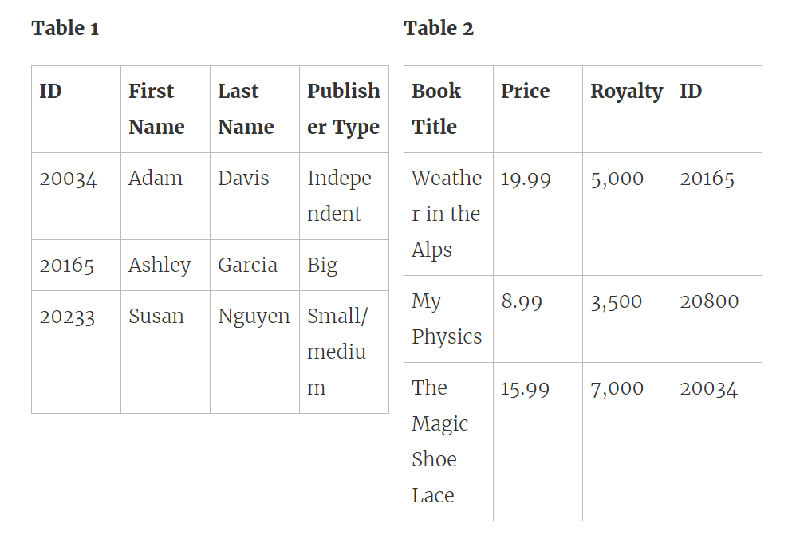

Slide 5
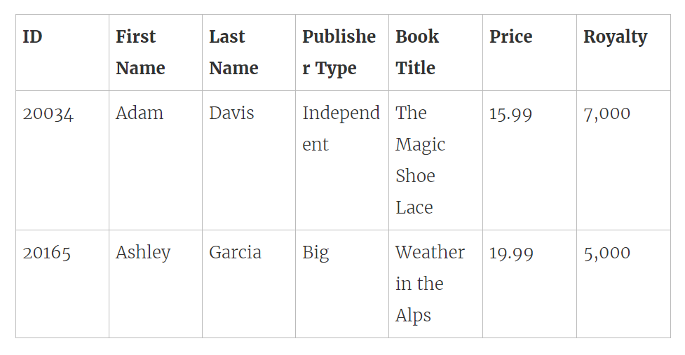
In order to analyze these two tables together, you can join the tables on ID to answer questions like, "How much was paid in royalties for authors from a given publisher?".
By combining tables using a join, you can view and use related data from different tables in your analysis.

Slide 6
Overview of join types
In general, there are four types of joins that you can use to combine your data in Tableau: inner, left, right, and full outer.
The tables you can join and the different join types you can use depend on the database or file you connect to.

Slide 7
Inner Join: When you use an inner join to combine tables, the result is a table that contains values that have matches in both tables.
Left Join: When you use a left join to combine tables, the result is a table that contains all values from the left table and corresponding matches from the right table. When a value in the left table doesn't have a corresponding match in the right table, you see a null value in the data grid.
Right Join: When you use a right join to combine tables, the result is a table that contains all values from the right table and corresponding matches from the left table. When a value in the right table doesn't have a corresponding match in the left table, you see a null value in the data grid.
Full Outer: When you use a full outer join to combine tables, the result is a table that contains all values from both tables. When a value from either table doesn't have a match with the other table, you see a null value in the data grid.
Union: Though union is not a type of join, union is another method for combining two or more tables by appending rows of data from one table to another. Ideally, the tables that you union have the same number of fields, and those fields have matching names and data types.

Slide 8


Slide 9
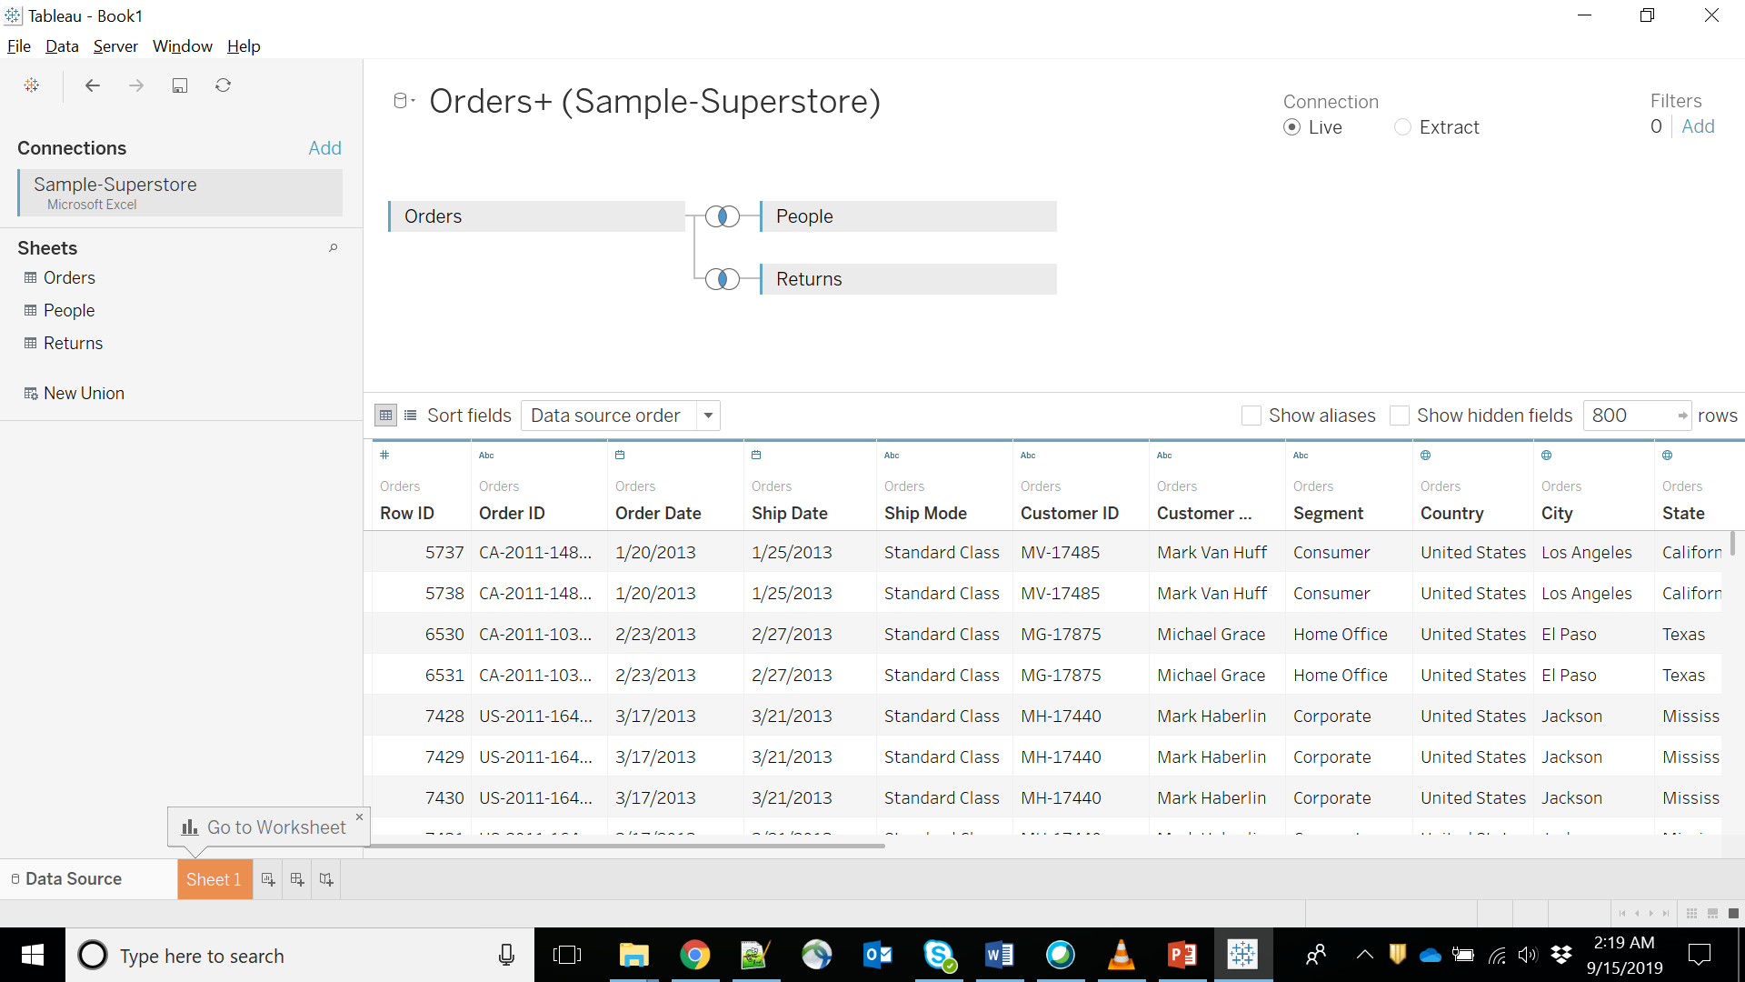

Slide 10
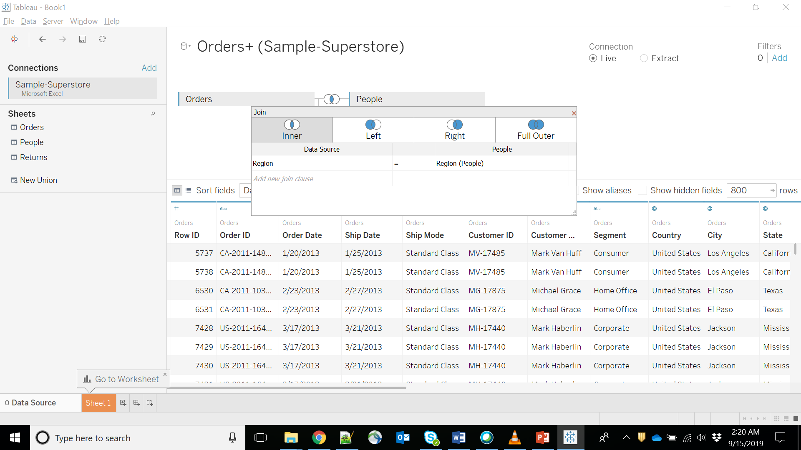

Slide 11
